Slide 1


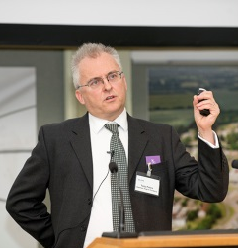
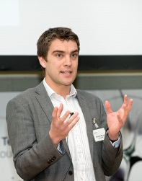
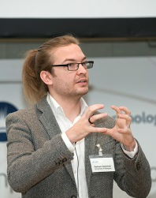

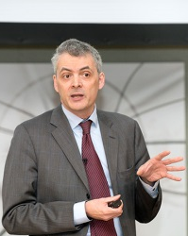
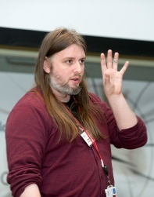
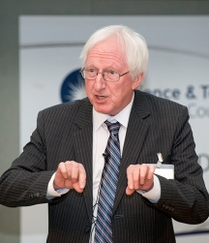
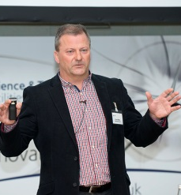
Cryogenic Cluster Day Nine Friday May 24 from 9.30 at Rutherford Appleton Laboratory
Speakers (from 10.00) Exhibitors
Richard Clarke Helium Solutions
Chris Ballentine Oxford University
One Speaker tbc Air Liquide
Richard Down ISIS Bestobell Valves
Pascale Dauguet Air Liquide Boiswood
Neil Ritson Helium Resources British Cryogenics Council
Cryo Storage
Posters : Oxford & Durham Universities, ISIS Helium Resources Ltd Kelvin Technology
Leybold
Proactive Gas Safety
Rotarex
RUAG Space
STFC
Sumitomo Cryogenics
Torr Scientific
Lab Visit : Helium Recycling Facility at ISIS Neutron Source
Registration : https://www.eventbrite.co.uk/e/cryogenic-cluster-day-2019-ccd9-registration-58656368778

